Slide 1


Slide 2
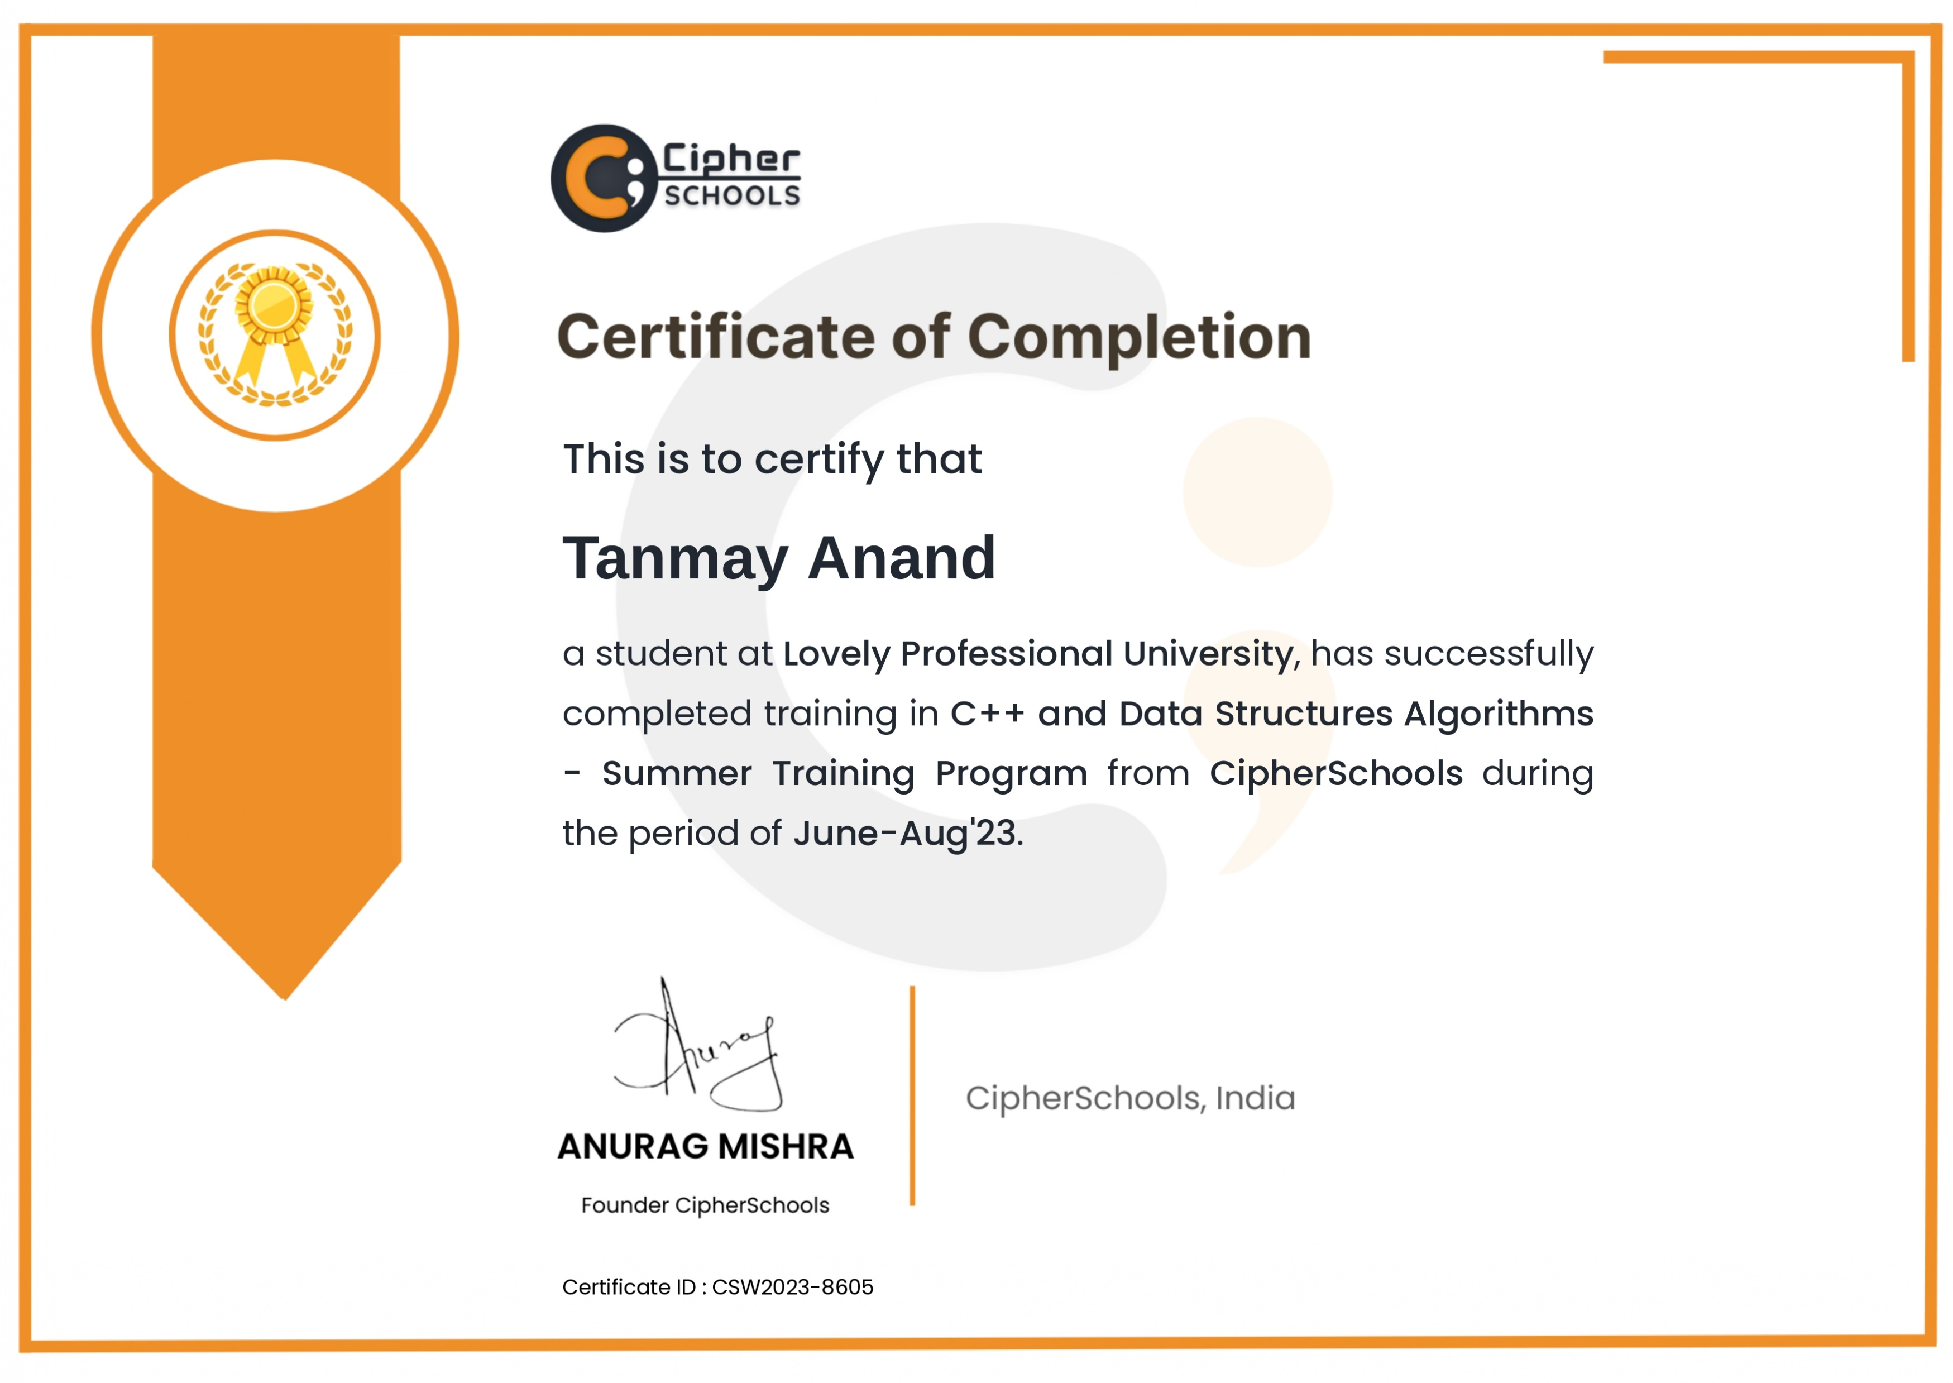

Slide 3

Topics
Arrays
Searching
Sorting
Linked List
Stack
Queue
Tree
Binary Search Tree
Heap
Graph

Slide 4
Data Structures and Algorithms
A data structure is a method of organizing data in a virtual system. Think of sequences of numbers, or tables of data: these are both well-defined data structures.
An algorithm is a sequence of steps executed by a computer that takes an input and transforms it into a target output.

Slide 5
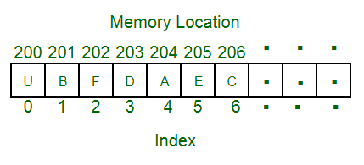
Array
An array is a collection of items of same data type stored at contiguous memory locations.

Slide 6
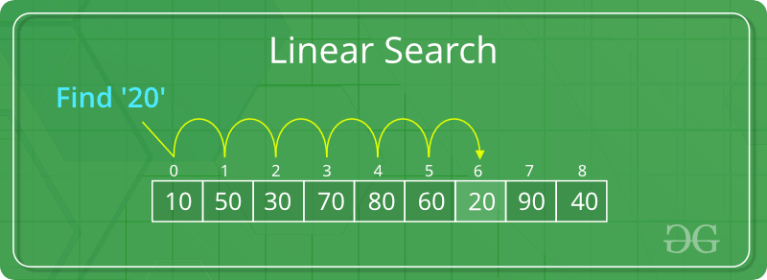
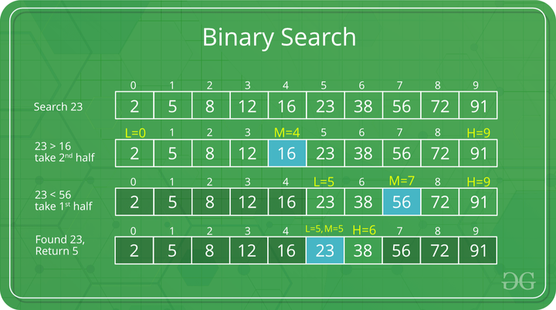
Searching
Searching an array means to find a particular element in the array. The search can be used to return the position of the element or check if it exists in the array.
Linear Search
This search starts from one end of the array and keeps iterating until the element is found, or there are no more elements left
Binary Search
The principle of binary search is how we find a page in book. We open the book at a random page in the middle and based on that page we narrow our search to the left or right of the book. Indeed, this only is possible if the page numbers are in order.

Slide 7
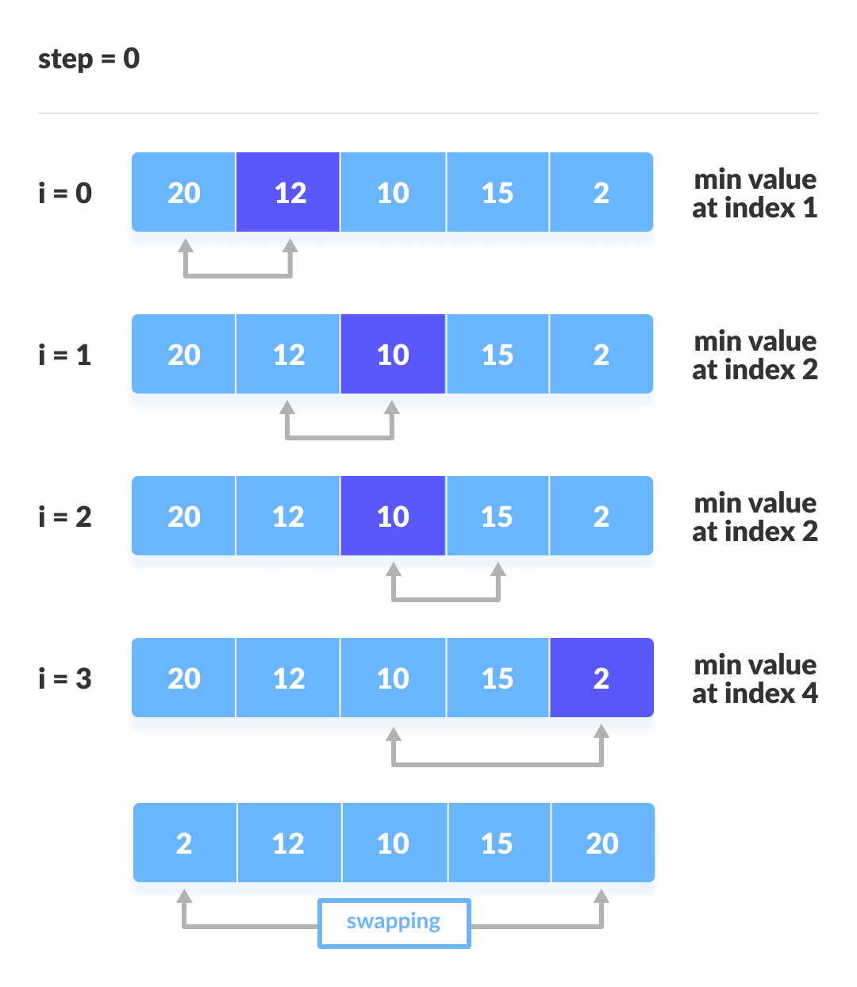
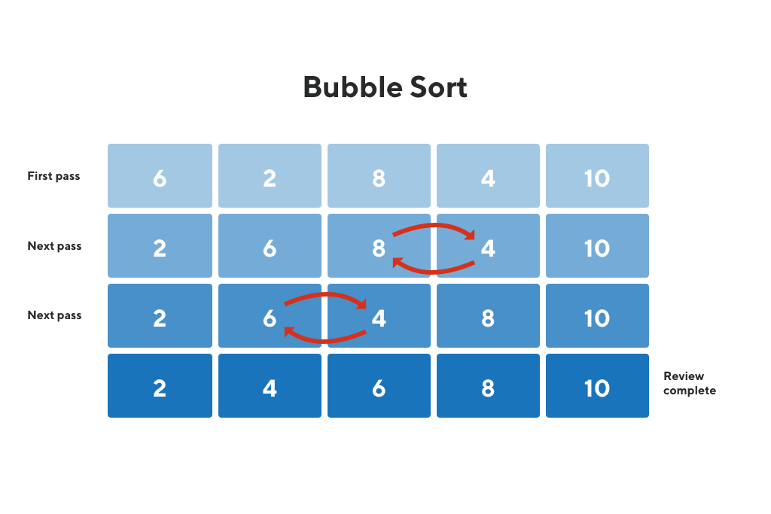
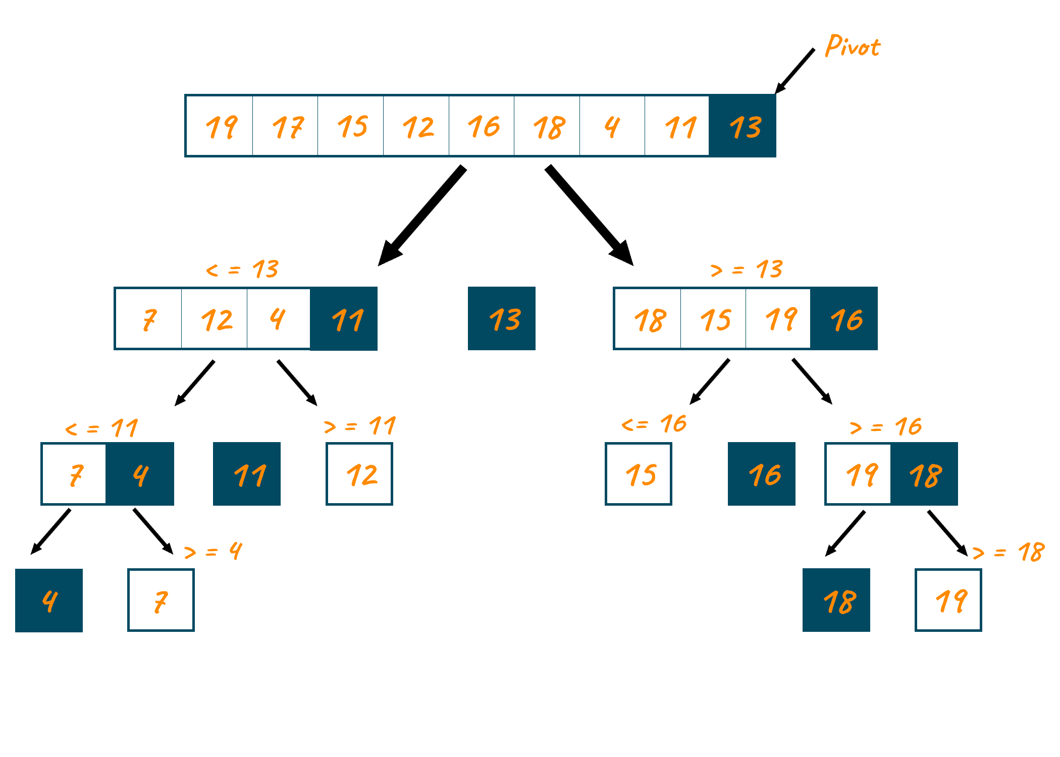
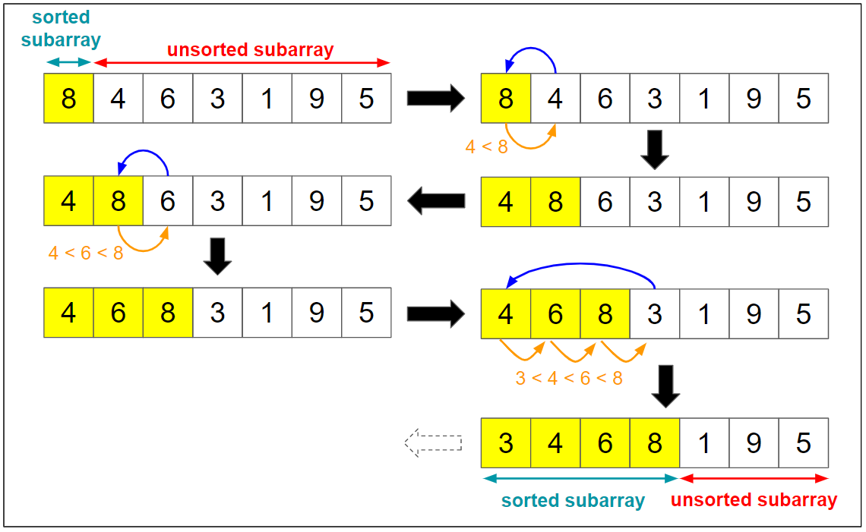
Sorting
Sorting an array means to arrange the elements in the array in a certain order. Various algorithms have been designed that sort the array using different methods
Bubble Sort
Insertion Sort
Selection Sort
Quick Sort

Slide 8
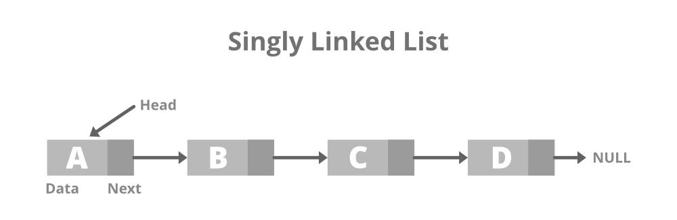
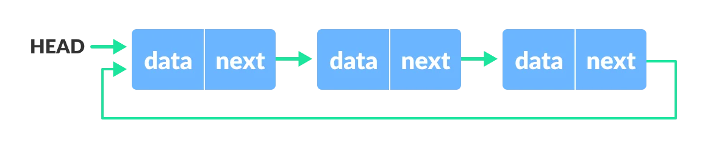

Linked List
A linked list is a linear data structure, in which the elements are not stored at contiguous memory locations. The elements in linked list are linked using pointers.
Circular Linked List
The circular linked list is a linked list where all nodes are connected to form a circle. In a circular linked list, the first node and the last node are connected to each other which forms a circle. There is no NULL at the end
Doubly Linked List
A Doubly Linked List contains an extra pointer, typically called the previous pointer, together with the next pointer and data which are there in the singly linked list.

Slide 9
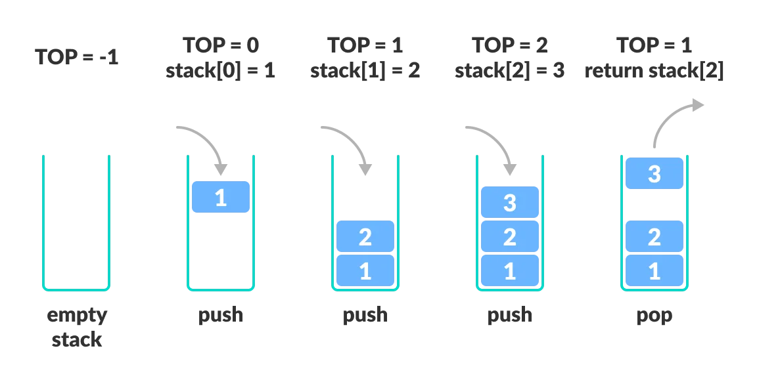
Stack
A stack is linear data structure that follows the principle of Last In First Out (LIFO). This means the last element inserted inside the stack is removed first.
Basic Operations of Stack
Push: Add an element to the top of a stack
Pop: Remove an element from the top of a stack
IsEmpty: Check if the stack is empty
IsFull: Check if the stack is full
Peek: Get the value of the top element without removing it.

Slide 10
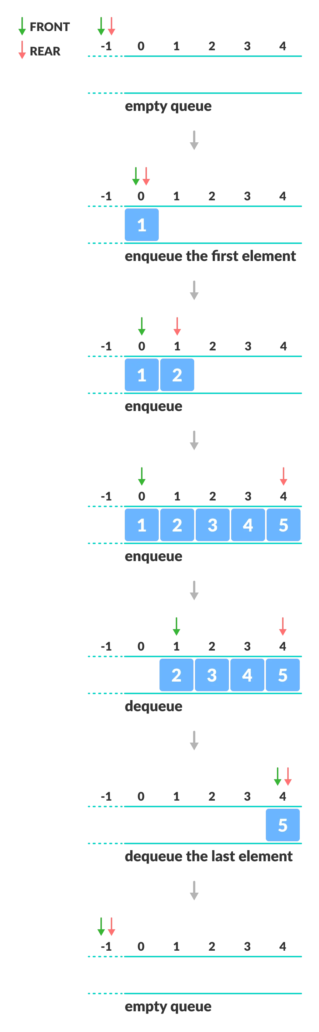
Queue
A queue is defined as a linear data structure that is open at both ends and the operations are performed in First In First Out (FIFO) order.
Basic Operations of Queue
Enqueue: Add an element to the end of the queue.
Dequeue: Remove an element from the front of the queue.
IsEmpty: Check if the queue is empty.
IsFull: Check if the queue is full.
Peek: Get the value of the front of the queue without removing it.

Slide 11
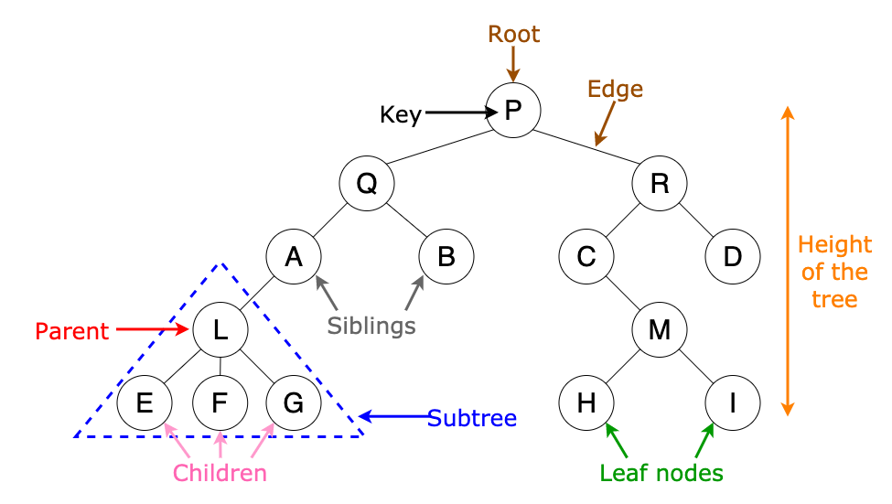
Tree
A tree is non-linear and a hierarchical data structure consisting of a collection of nodes such that each node of the tree stores a value and a list of references to other nodes (the “children”).
Tree Terminologies
Node
A node is an entity that contains a key or value and pointers to its child nodes.
The last nodes of each path are called leaf nodes or external nodes that do not contain a link/pointer to child nodes.
The node having at least a child node is called an internal node.
Edge
It is the link between any two nodes.
Root
It is the topmost node of a tree.
Height of a Node
The height of a node is the number of edges from the node to the deepest leaf (ie, the longest path from the node to a leaf node.)
Depth of a Node
The depth of a node is the number of edges from the root to the node.
Height of a tree
The height of a Tree is the height of the root node or the depth of the deepest node.
Degree of a node
The degree of a node is the total number of branches of that node.
Forest
A collection of disjoint trees is called a forest

Slide 12
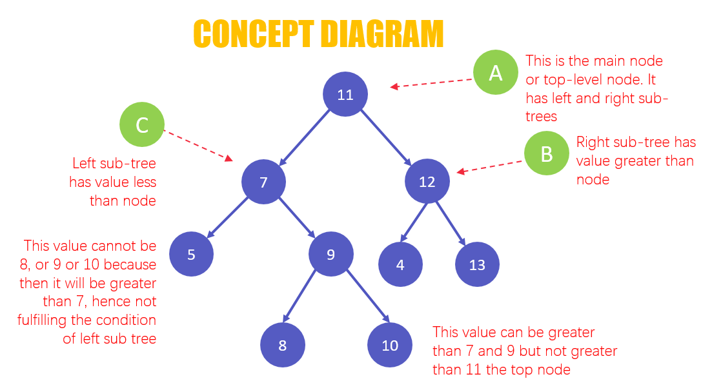
Binary Search Tree
Binary search tree is a data structure that quickly allows us to maintain a sorted list of numbers.
It is called a binary tree because each tree node has a maximum of two children.
It is called a search tree because it can be used to search for the presence of a number in O(log(n)) time.
The properties that separate a binary search tree from a regular binary tree is
All nodes of left subtree are less than the root node
All nodes of right subtree are more than the root node
Both subtrees of each node are also BSTs i.e. they have above two properties
Operation on binary search tree:
Search Operation
Insert Operation
Deletion Operation

Slide 13
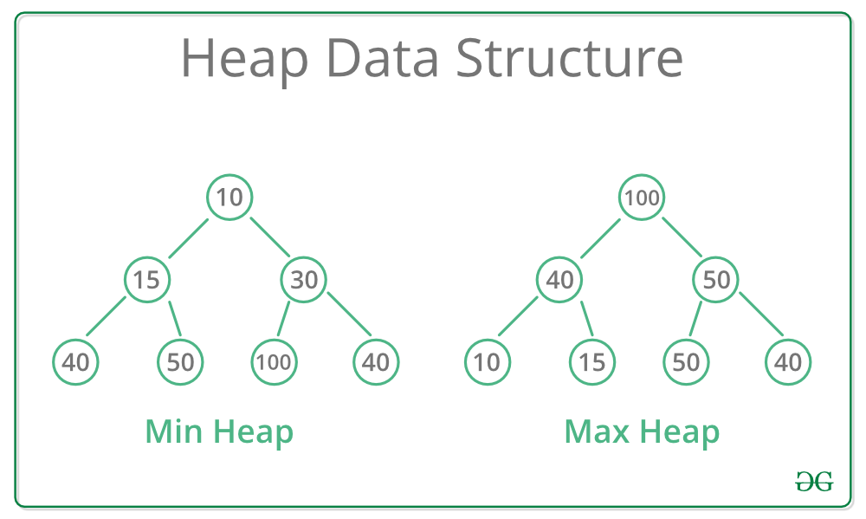
Heap
Heap data structure is a complete binary tree that satisfies the heap property, where any given node is
Always greater than its child node and the key of the root node is the largest among all other nodes. This property is also called max heap property.
Always smaller than the child node and the key of the root node is the smallest among all other nodes. This property is also called min heap property.
Heap Operations
Heapify
Insert Element into Heap
Delete Element from Heap
Peek (Find max/min)
Extract-Max/Min

Slide 14
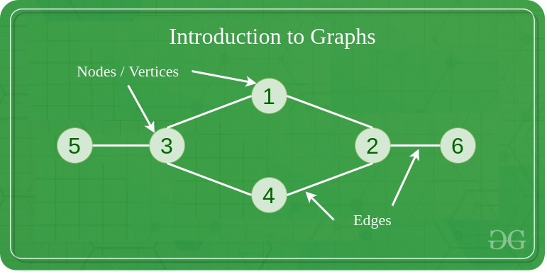
Graph
A Graph is a non-linear data structure consisting of vertices and edges. The vertices are sometimes also referred to as nodes and the edges are lines or arcs that connect any two nodes in the graph. More formally a Graph is composed of a set of vertices(V) and a set of edges(E). The graph by G(E,V).
A collection of vertices V.
A collection of edges E, represented as ordered pairs of vertices (u,v)
Graph Terminology
Adjacency: A vertex is said to be adjacent to another vertex if there is an edge connecting them. Vertices 2 and 3 are not adjacent because there is no edge between them.
Path: A sequence of edges that allows you to go from vertex A to vertex B is called a path. 0-1, 1-2 and 0-2 are paths from vertex 0 to vertex 2.
Directed Graph: A graph in which an edge (u,v) doesn’t necessarily mean that there is an edge (v,u) as well. The edges in such a graph are represented by arrows to show the direction of the edge.
Graph Operations
Check if the element is present in the graph
Graph Traversal
Add elements (vertex, edges) to graph
Finding the path from one vertex to another.

